Slide 1

END OF STUDIES PROJECT QuantLib 1.3
Presented by: | Ahmed Ayadi Nathan D.Kruck Nolan Potier | Supervised by: | Mme. Anne Marie HUGUES & Mr. Luigi BALLABIO

Slide 2
Plan
II-Library components
III-Barrier Options
V-Work flow
I-QuantLib Presentation
IV-Partial-Time Barriers

Slide 3
I-QuantLib 1.3
Quants and Developers
C++ , 2000
Ferdinando Ametrano and Luigi Ballabio
Open Source Initiative Certified
Boost library
Notes:
-The initial QuantLib release was 0.1.1 in Nov 2000
-Is primarily the work of Ferdinando Ametrano and Luigi Ballabio
-Boost has been a QuantLib requirement since July 2004

Slide 4
II-Library components
Organized into modules.
Covering specific aspect of functionalities
Set of functions, classes,
Collection of macros and typedefs.

Slide 5
II-Library components
Macros <ql/
qldefines.hpp>
Design patterns <ql/patterns>
Utilities <ql/utilities>
Numeric types <ql/types.hpp>
Financial instruments <ql/instruments>
Models <ql/models>
Methods <ql/methods>
Pricing engines <ql/
pricingengines>
Most important Modules
Notes:
-Global definitions and macros to help porting the code to different compilers.
-C++ template implementations of some software design patterns used in the QuantLib library
-Various utility classes like data formatting and parsing.
-Numeric types where defined to add clarity to method declarations.
-Defines a collection of financial instruments.
-Implementation of some widely used mathematical models.
-Methods contains basic building blocks for the implementation of pricing calculations..
-Pricing engines contains a flexible framework for pricing. It contains many predefined engines.

Slide 6
III-Barrier Options
Path-dependent option
Traded in the late 60s
Many types
Initiated or Exterminated
Notes:
the price is based on the fluctuations in the underlying's value during all or part of the contract term.

Slide 7
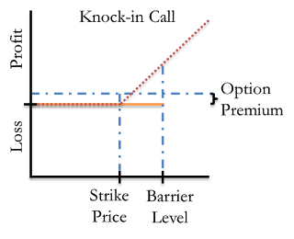
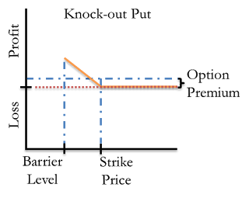
III-Barrier Options

Slide 8
IV-Partial-Time Barrier Options
The addition of a trigger window
It is monitored for a specific period
The barrier is inactive for part of the option's life, at the beginning section or the end
Two distinct types:
partial-time start options
partial-time end options
Notes:
-These are similar to regular barrier options, the behavior is modified by the addition of a trigger window.
-It is monitored for hits only during specific points in time.
That means the barrier is inactive for part of the option's lifespan.
-The monitoring period can be at the beginning section or the end section of the option's life.
-Two distinct types:
partial-time start options, which have a knock-out barrier at the beginning of the option's life that is removed at some preset point in time
partial-time end options (or protected barrier options), which cannot be knocked out at the beginning of their lives.

Slide 9
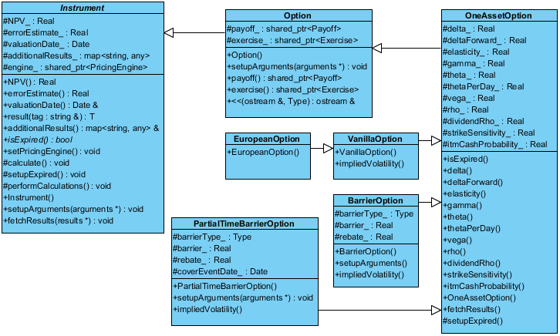
V-Our Solution

Slide 10
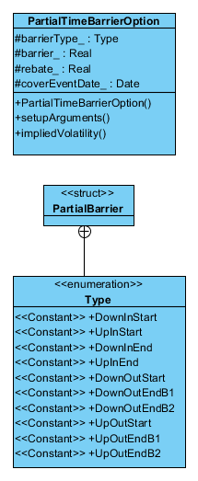
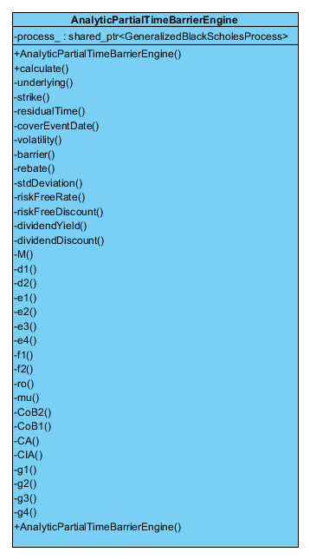
V-Our Solution

Slide 11
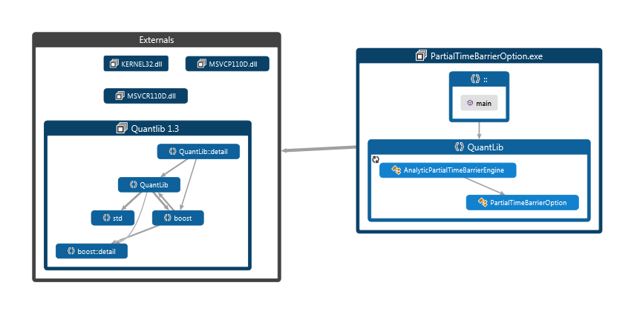
V-Our Solution
Dependency Graph

Slide 12
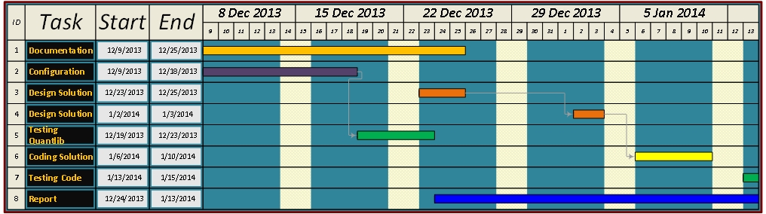
V-Work flow

Slide 13
Thank You ☺
Questions

